Slide 1

ENROLLEMENT MANAGER
By : Mahalakshmi
Course : Programming Using Python
Batch Code: DA644S64
Project Guide: Priya Shanmugam

Slide 2
Problem Statement
Student enrollment in many institutions is managed manually or using spreadsheets
Manual enrollment leads to data duplication and entry errors
Tracking enrolled students and assigned courses becomes difficult
Updating or modifying enrollment details is time-consuming
Lack of a centralized system for managing student and course data
Difficulty in generating enrollment reports quickly
Increased administrative workload due to repetitive tasks
Need for an automated, accurate, and user-friendly enrollment management system
Requirement of a Python-based solution to efficiently manage enrollment processes

Slide 3
Objectives
To design and develop a Python-based system for managing student enrolments efficiently
To automate student registration and course enrollment processes
To maintain centralized records of students, courses, and enrollment status
To reduce manual effort and minimize data entry errors
To provide easy search, update, and deletion of enrollment records
To generate basic reports such as enrolled students per course
To ensure data consistency and proper validation during enrollment
To improve administrative productivity through automation

Slide 4

Database Overview
The Enrollment Manager System uses a Python-based in-memory database structure to manage student admissions efficiently
Data is organized using Python classes and objects, simulating real-world database tables
The system maintains student admission records, course details, fee status, and enrollment history
Each student record includes personal details such as roll number, name, age, mobile number, and email
Enrollment data tracks courses assigned, teachers, fees paid, total fees, and course status
Admission status is dynamically updated as Enquiry, Pending, or Enrolled based on fee confirmation

Slide 5
Contd..Database Overview
Enrollment dates are automatically generated to simulate real admission timelines The system supports CRUD operations (Create, Read, Update, Delete) for admission records Multiple views are provided to Analyse confirmed admissions, pending fees, and enquiry students The structure is designed to be scalable, allowing future integration with files or databases like SQLite AI integration (Groq) enables intelligent analysis and insights from enrolment data

Slide 6
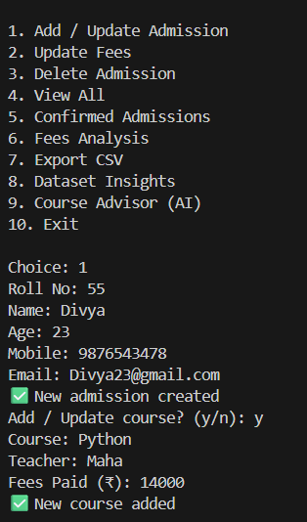
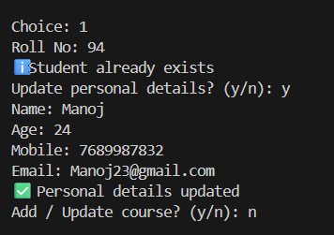
Add / update Admission:
Add / Update Admission
The system captures complete student details including personal info, course selection, teacher assignment, and fees.
It simplifies the admission process by saving structured data with instant confirmation.
Python Concepts Used: Constructor (__init__)
The constructor initializes student details when a new admission object is created.
Python Concepts Used:
Input & Output Conditional Statements
Functions
Python functions capture user input and conditionally add or update admission records.

Slide 7
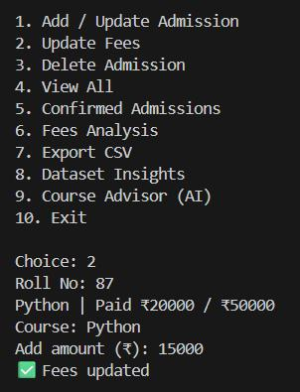
Update fees:
The fee update module allows incremental payment tracking against the total course fee.
It ensures real-time fee balance updates and confirms successful transactions instantly.
Python Concepts Used:
Conditional Logic
Arithmetic Operations
Fee payments are updated using conditions to confirm enrollment automatically.

Slide 8
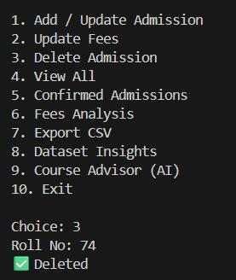
Delete Admission:
The system successfully deleted the admission record with Roll No. 74 from the database.
This confirms effective record management and helps maintain accurate and up-to-date admission data.
Python Concepts Used:
Conditional Statements
List Operations
Python removes student objects safely from the data structure.

Slide 9
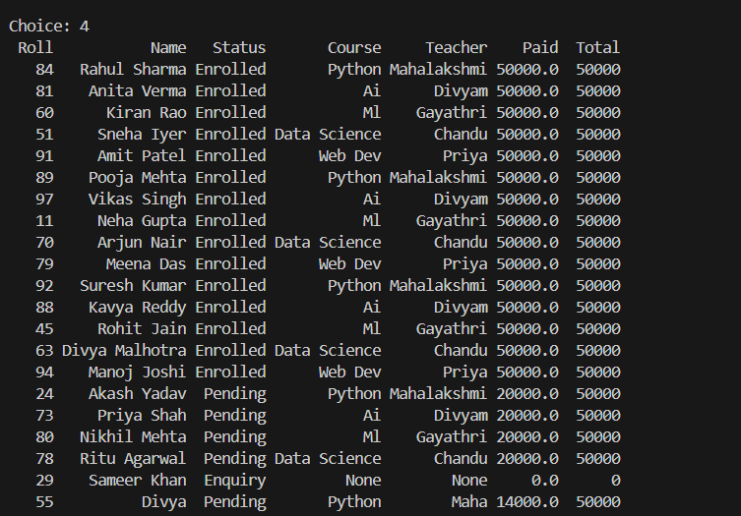
View all Admission Details:
View All Admissions (Detailed View)
The complete admission dataset is displayed with roll number, status, course, teacher, and fee details.
It offers a comprehensive operational view of enrolled, pending, and enquiry students in one place.
Python Concepts Used:
Loops
Formatted output
Loops are used to display complete admission records in a structured format.

Slide 10
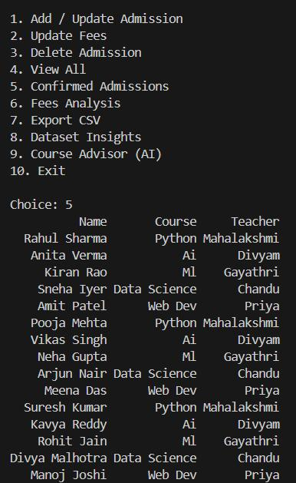
Confirmed admission:
This screen lists all confirmed students along with their selected course and assigned faculty.
It helps management quickly track finalized admissions and instructor allocation.
Python Concepts Used:
Conditional Filtering
Data Validation
Python filters and displays only fully paid and confirmed admissions.

Slide 11
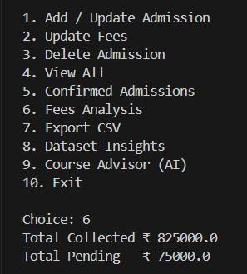
Fees analysis :
This module summarizes total fees collected and outstanding pending amounts.
It provides a quick financial overview to support revenue tracking and follow-ups.
Python Concepts Used:
NumPy
Numerical Computation
NumPy calculates total collected fees and pending amounts efficiently.

Slide 12
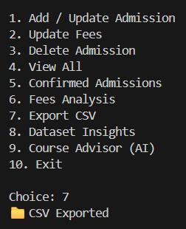
Export CSV file:
The system allows exporting admission data into a CSV file for external use.
This enables easy reporting, backup, and data sharing with stakeholders.
Python Concepts Used:
File Handling
CSV Module
Python exports admission data into CSV files for reporting and backup.

Slide 13
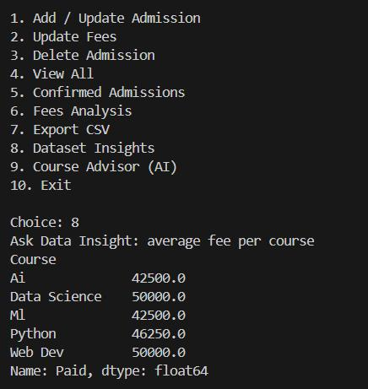
Dataset Insights:
Average Fee per Course:
Data Science and Web Development have the highest average fees at ₹50,000 each.
AI and ML are priced moderately (₹42,500), while Python stands at an average of ₹46,250.
Python Concepts Used:
Pandas
Library Data Analysis
Pandas analyzes average fees and pending payments per course.

Slide 14
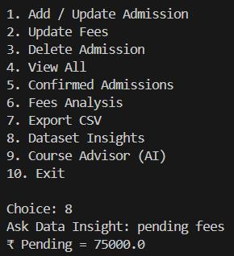
Dataset Insights:
Pending Fees:
The system reports total pending fees of ₹75,000, indicating outstanding payments to be collected.
This highlights the need for follow-ups to improve cash flow and fee closure.
Python Concepts Used:
Aggregation Functions
Conditional Logic
Python identifies outstanding fees to support follow-up actions.

Slide 15
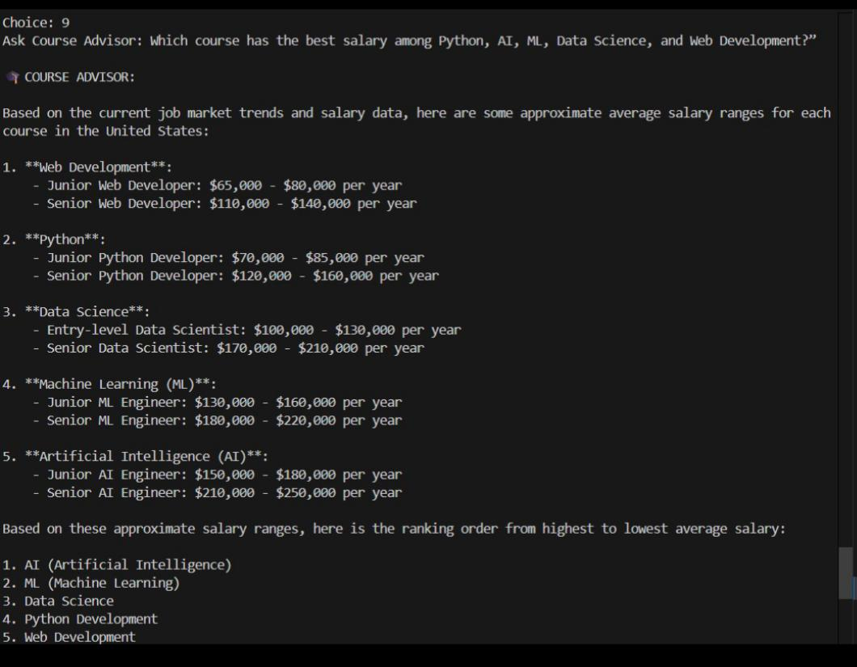
Course Advisor (AI):
Salary Comparison:
AI and ML roles command the highest salary ranges, followed by Data Science.
Python and Web Development offer comparatively lower but stable salary prospects.
Python Concepts Used:
AI Integration
API Handling
Python integrates AI to provide course and career recommendations.

Slide 16
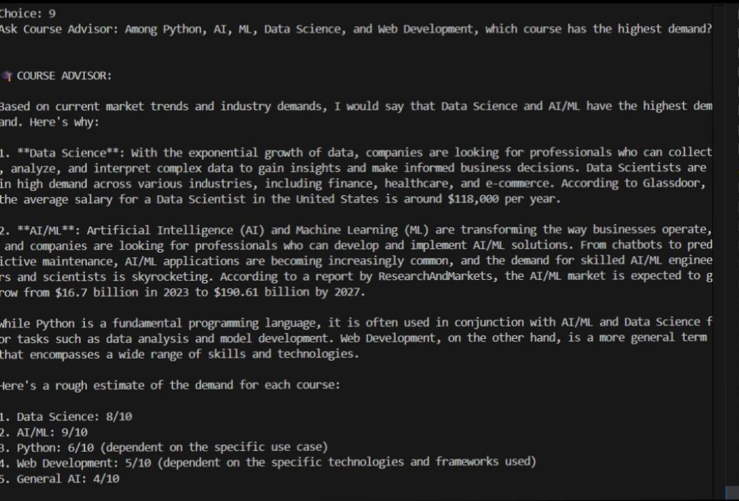
Course Advisor:
Demand Analysis:
AI/ML and Data Science show the highest market demand compared to Python and Web Development.
This suggests strong industry preference for data-driven and intelligent technologies.
Python Concepts Used:
Data Analysis
AI-Based Insights
Python analyzes industry demand and salary trends using AI responses.

Slide 17

Key Python Concepts Used
Exception Handling
Python Concept Used:
Try–Except Blocks
Handles invalid inputs and runtime errors gracefully.
Advantages of Python
Python Concepts Used:
Extensive Libraries
Simplicity
Scalability
Enables fast development, scalability, and easy maintenance.
Integration of Concepts
Python Concepts Used:
Integration of Python, OOP, Data Analysis, and AI
Demonstrates the real-world application of Python programming, Object-Oriented Programming (OOP), data analysis, and AI.

Slide 18
Conclusion
Successfully developed a Python-based Enrollment Manager system
Automated student enrollment and course management process
Reduced manual work and minimized data entry errors
Provided centralized management of student, course, and fee details
Implemented dynamic enrollment status tracking (Enquiry, Pending, Enrolled)
Demonstrated effective use of Python concepts like OOP and exception handling
Enabled multiple views and reports for better decision-makingg
Designed the system to be scalable for future database and web integration

Slide 19
Thank You

